Slide 1
PATRICIA ROBERTSON FUND (PRF) MARCH 2020
The fund is named after our founder and patron and it is a national project of the Association of ADFAS. The fund supports mid career conservators and student conservators emerging from the Universities of Canberra and Melbourne’s Material Conservation Courses in partnership with The Australian Institute for the Conservation of Cultural Material (AICCM)

Slide 2
PRF and AICCM partnership
Philanthropy is central to the ADFAS ethos, the PRF has a commitment to advance conservation practice and deliver through awards, support to conservation professionals and raise the profile of ADFAS amongst those interested in cultural materials.
The agreement offers an annual award of $2000 to a mid-career conservator with a minimum of ten years practice. The awardee will be known as the ADFAS Mid-Career Scholar. Two additional awards of $1000 will be awarded annually to the AICCM Student of the Year at both the University of Melbourne and Canberra University’s Material Conservation Courses in line with current criteria.
The successful awardees will be announced at the AICCM Annual Conference
in November of each year.

Slide 3
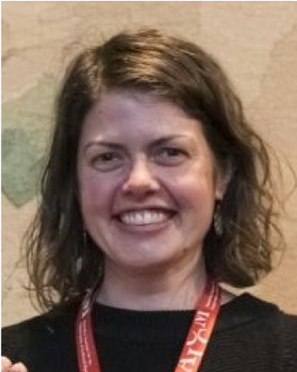
2019 ADFAS Mid-Career Scholar Elizabeth McCartney Manager,Conservation Museums Victoria
Elizabeth has been awarded the scholarship to attend the course ‘Conservation and Repair of Architectural and Structural Metalwork’ at West Dean College of Arts and Conservation (UK) in February 2020. In her role Elizabeth directs the conservation program that looks after the Victorian State Collection. The collection is substantial and varied and it includes a large number of technology items made from metal. In particular, she is the project conservator for the Great Melbourne Telescope (GMT) Restoration. The telescope was erected at the Melbourne Observatory in 1869, for three decades the GMT was the largest operational telescope in the world.
It was relocated to Mt Stromlo in1945 for astrophysical research, in 2003 the original parts still in use were severely burnt in the devastating bushfires. The remaining parts were relocated back to Melbourne in 2008 and the restoration began on this object of great state, national and international significance.
The restoration project has arrived at a critical juncture and further development of knowledge of metals conservation is important as there is no metals-specific mid-career conservation training in Australia.

Slide 4
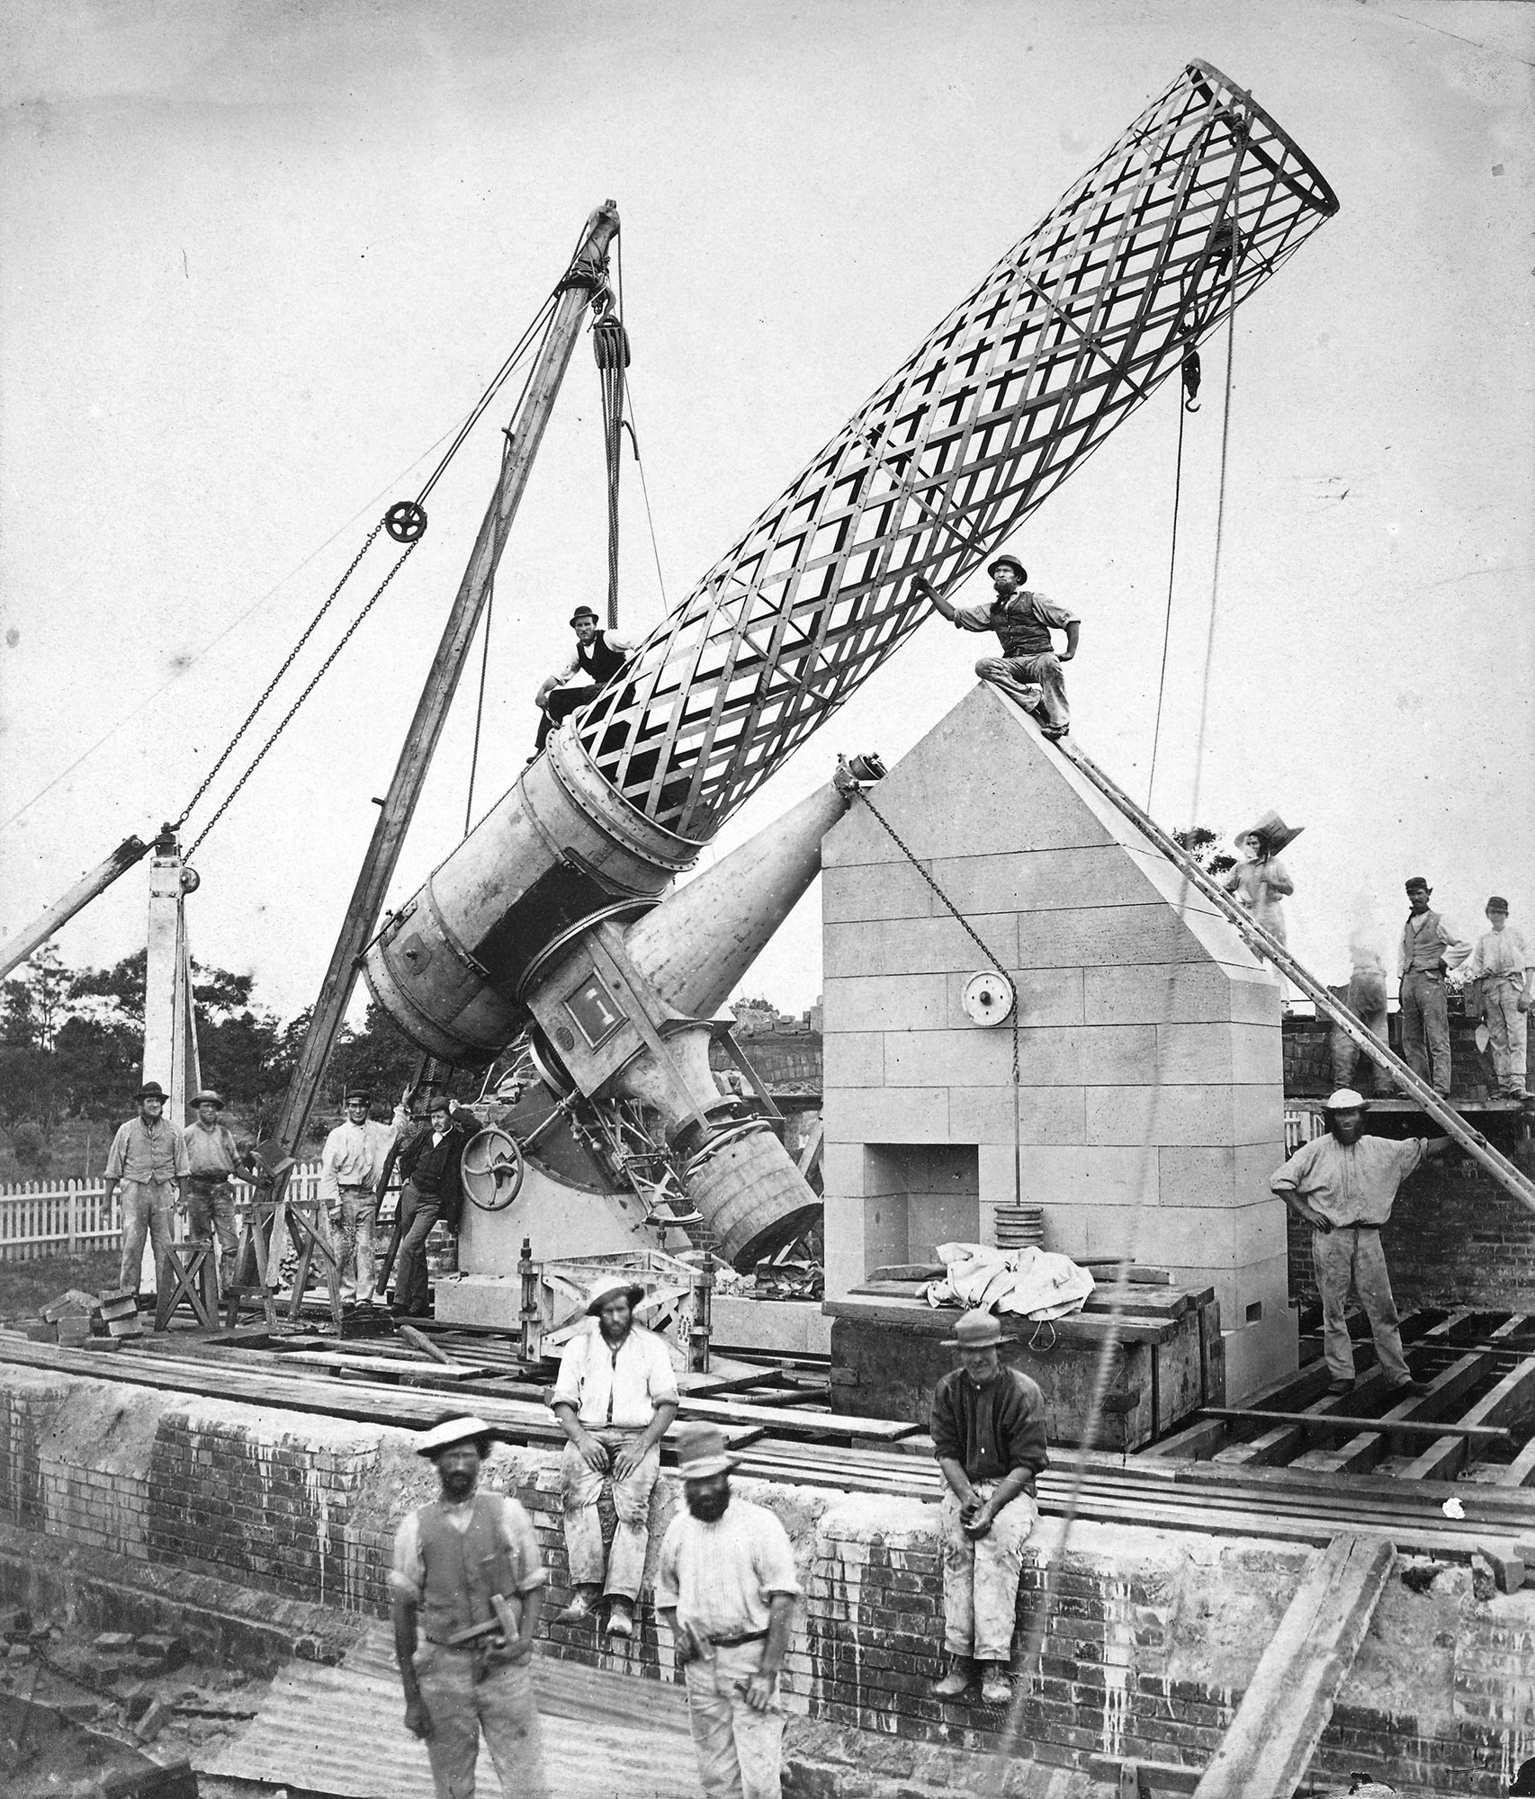
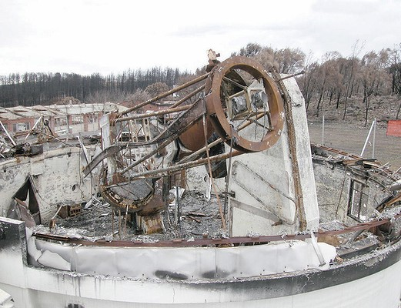
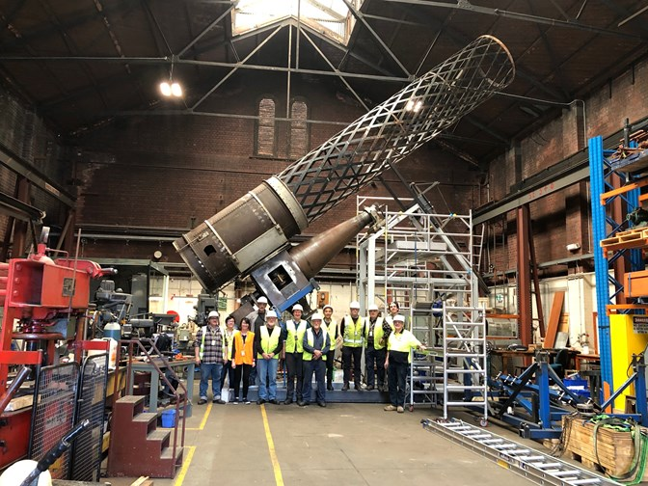
The Great Melbourne Telescope restoration Project
1869 Melbourne Observatory 2003 Mt Stromlo 2019 Museums Victoria
2003

Slide 5
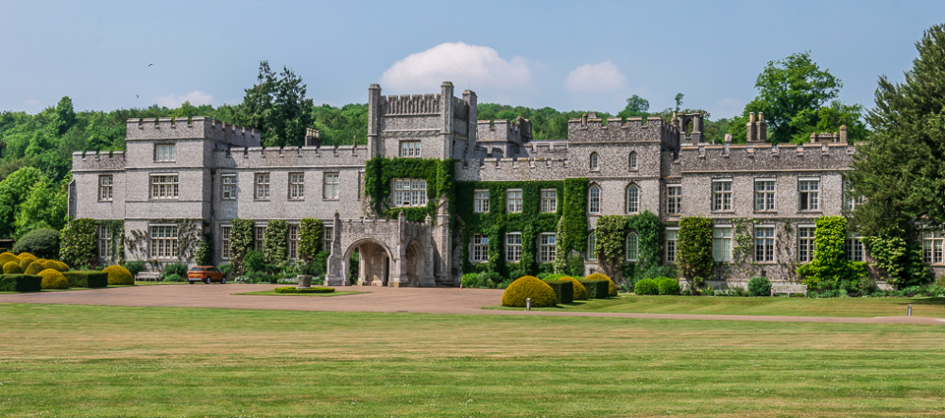
WEST DEAN COLLEGE OF ARTS AND CONSERVATION UK
Elizabeth was fortunate to attend the short course before travel restrictions of Covid-19 were enforced. It has been of great benefit to her and this will now allow for more informed metal conservation to be applied to the GMT and other significant Victorian State objects and structures.

Slide 6
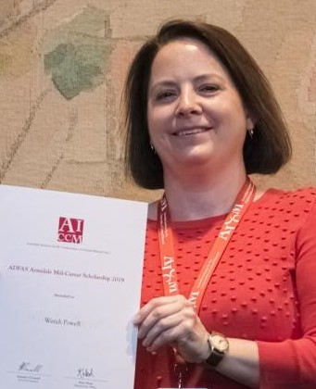
2019 ADFAS Armidale mid-career scholar Wendi Powell
ADFAS Armidale sponsored an additional award in 2019 to Wendi Powell, Senior Paper Conservator at International Conservation Services Sydney, to secure a place in the 7 week long Preservation & Conservation of Photographic Materials Course held by the Centre for Photographic Conservation in London UK in April 2020. This is a seven week ‘Certificated’ career and professional development course held annually for experienced conservators seeking to increase and develop their knowledge, skills and experience in the field of photographic conservation.
This course will help Wendi to broaden her knowledge and skill base in the field of photographic conservation. The course entails the history of photography and the theory of photo-chemistry and as well teaches practical hands-on skills for the preservation and conservation treatment of photographic materials. It will also enable Wendi the opportunity to assemble a collection of comparative images for the identification of different types of photographic materials.

Slide 7
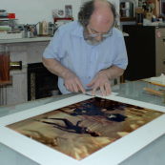
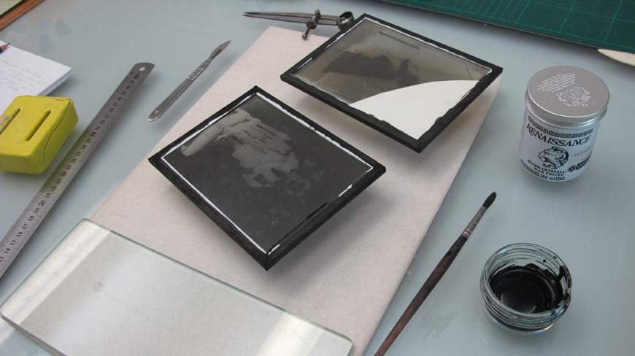
The Centre of Photographic conservation London
The course has been POSTPONED due to Covid-19.
Wendi will be attending when the course resumes.
Details will be released as soon as they are available.

Slide 8
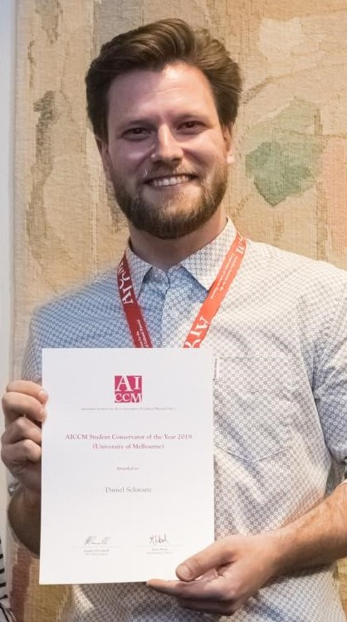
2019 AICCM Student of the year university of Melbourne Daniel schwartz
Daniel is a committed and strong advocate for cultural materials conservation and during his Masters of Cultural Materials Conservation he achieved high academic results and facilitated conservation programs with broader communities.
In particular, Dan led a Re-Org project at Bathurst Regional Gallery the first documented RE-ORG project in Australia with conservation and curatorship students conducting a reorganisation of the museum’s storage facility.
Such leadership and concern for the conservation profession is also shown by Dan’s role as the President of SC@M (Student Conservators @ Melbourne) and representation on the AICCM’s 2019 National Conference Conservation Skills Summit Panel.

Slide 9
Re-Org Bathurst regional gallery
Collections in storage are at risk.
95% of museums objects are kept in storage.
1 in 4 museums have incomplete documentation.
1 in 3 are unclear who is responsible for storage.
1 in 4 find it difficult to circulate in storage.
1 in 2 have insufficient storage units.
ICCROM- UNESCO International Storage Survey 2011

Slide 10
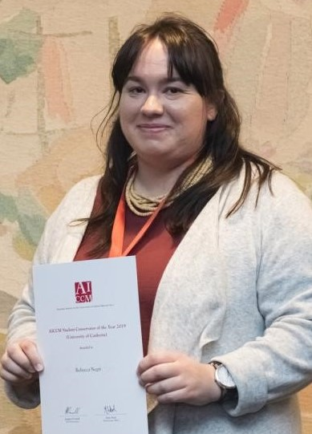
2019 student of the year university of Canberra Rebecca negri
Rebecca has been actively involved in the conservation profession and has undertaken internships with the Australian War Memorial and has undertaken significant work on a family portrait outside her regular studies. As well as treatment, this project has involved sympathetic liaison with the family to ensure their needs are met.
Rebecca has high academic achievement and is an outstanding student. She researches everything she does in depth, conducts extensive trials to determine the best materials and methods to use for her treatments, and has actively explored new areas of conservation methodology such as gel cleaning systems.
Rebecca is a leader in her chosen area of paintings conservation, and has actively contributed to the conservation profession both amongst her student peers and also with the professional conservators she has worked with. Her desire to explore and evaluate new techniques has inspired everyone around her to experiment and innovate.

Slide 11
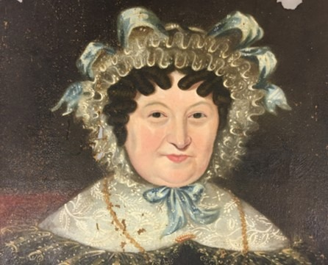
‘Aunty Hambrook’, a complicated 18th century portrait RESTORATION underway BY Rebecca Negri

Slide 12
conclusion
The ongoing success of the PRF is reliant on donations, the fund needs to grow to ensure that it can keep supporting conservators for many more years to come.
In 2019 twenty societies donated to the fund, so a big thank you for the donations, they are all greatly appreciated.
2020 is developing to be an unprecedent time in our history with bushfires,floods and now the global Covid -19 pandemic impacting on our lives with increasing daily challenges.
The PRF 2020 awards will be needed more than ever to help make a difference to the Australian cultural heritage after the pandemic chaos.
The PRF portfolio will be handed to Executive Member Libby Davis in April as I have completed my four year term on the ADFAS Executive. I will continue following with interest the PRF conservation journey.
My thanks again to all the societies who have supported the PRF in the last few years.
Julia Gamble - March 2020

